Slide 1
M5 Presentation
Team 4 - Doseedo

Slide 2
What is Doseedo?

Slide 3
Doseedo
Medication management app
For less tech savvy users- the old, the forgetful, the shaky
Two Accounts
Caregiver
Patient
Caregiver has the ability to
View and store medications
set medicine reminders for patient
Patient has full functionality or a linked caregiver account
Demonstration concept for a mobile app

Slide 4
Doseedo P1 Feature Delivery Review
Home/Landing Page (100%)
Login/Register/Logout and Session (100%)
Caregiver/Patient Dashboards (100%)
Account Linking
(100%)
Link account
Unlink account
Medications (View/Add/Remove) (100%)
Notifications
(60%)
Set Medication Reminders (100%)
Store Emergency Contact (Patient)
(100%)
Patient List (Caregiver)
(100%)
Profile (View/Edit)
(100%)

Slide 5
Doseedo UX Design
Concept Curation
Figma Mockups

Slide 6
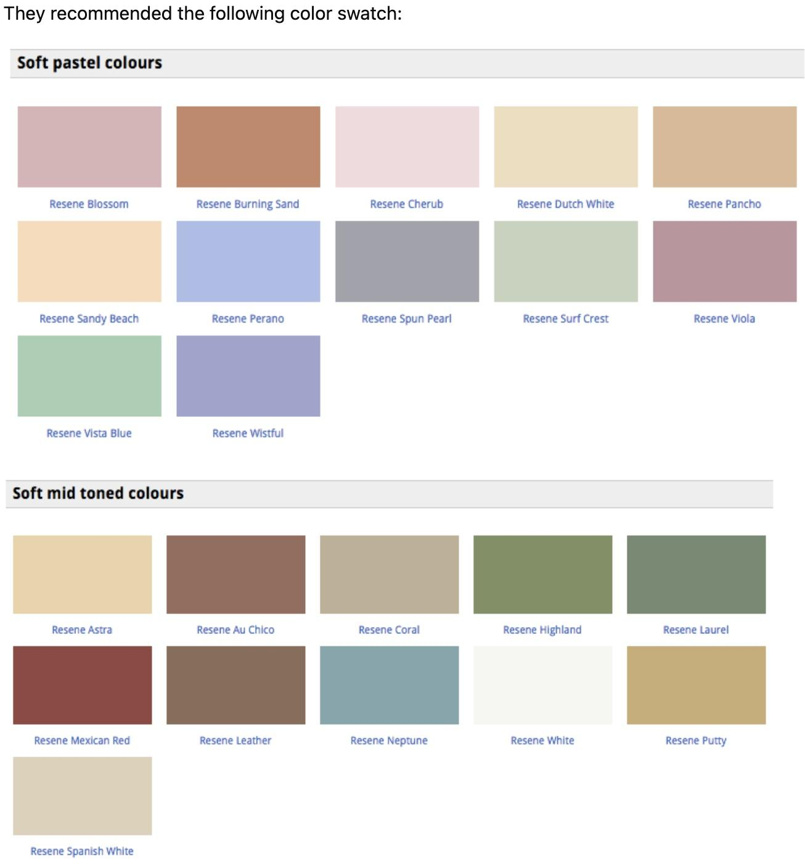
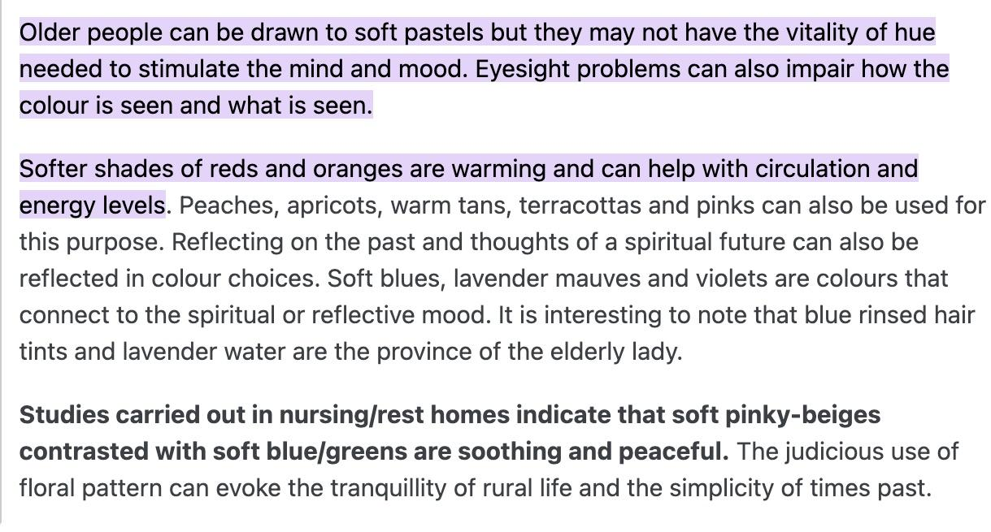
Concept Curation
We began our research by exploring color preferences among the elderly, aiming to identify hues that would be both appealing and user-friendly for them. Once we settled on a suitable color palette, we shifted our focus to enhancing accessibility within our application. Consequently, we prioritized the implementation of various features to simplify navigation for our elderly users:
An uncomplicated dashboard, featuring prominent icons and buttons upon initial login, ensuring visibility and ease of interaction.
Embracing a minimalist design across all pages, allowing users to concentrate on the content without unnecessary distractions.
Incorporating a large, easily accessible back button, enabling users to seamlessly navigate back to any previous page they desire.

Slide 7
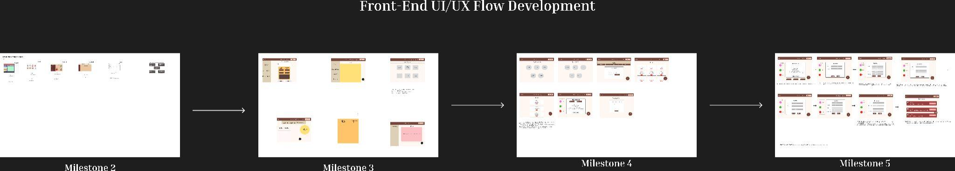
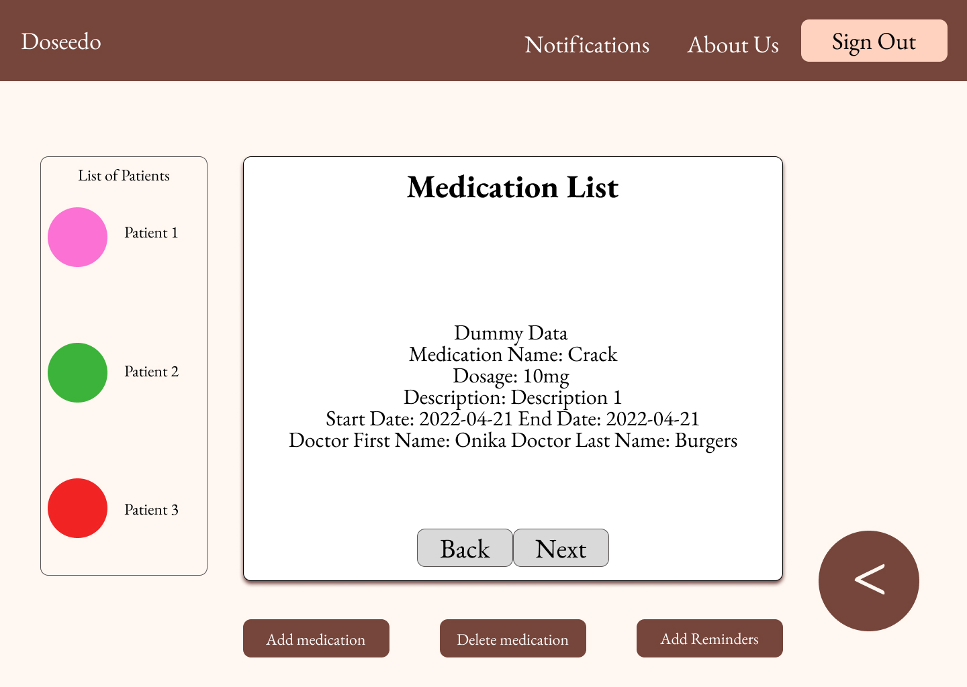
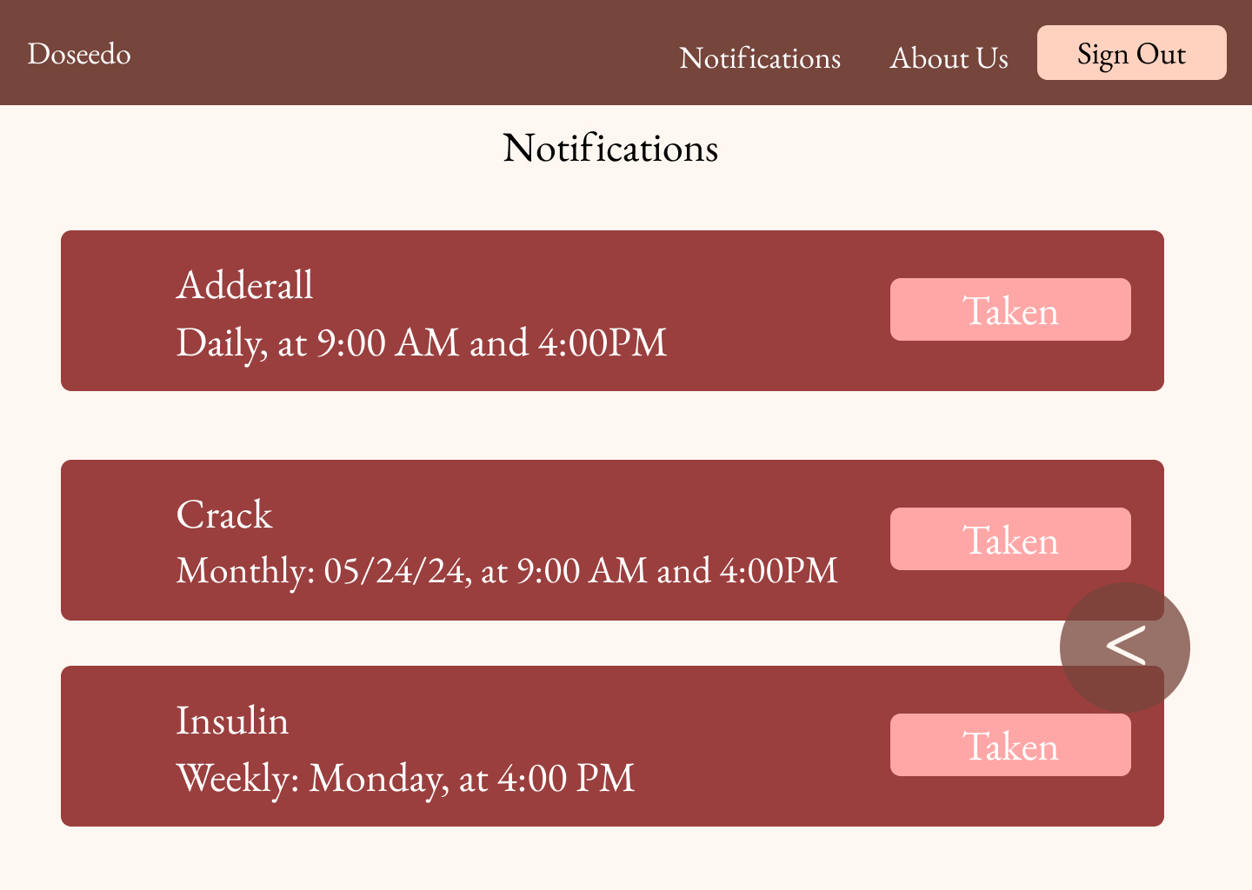
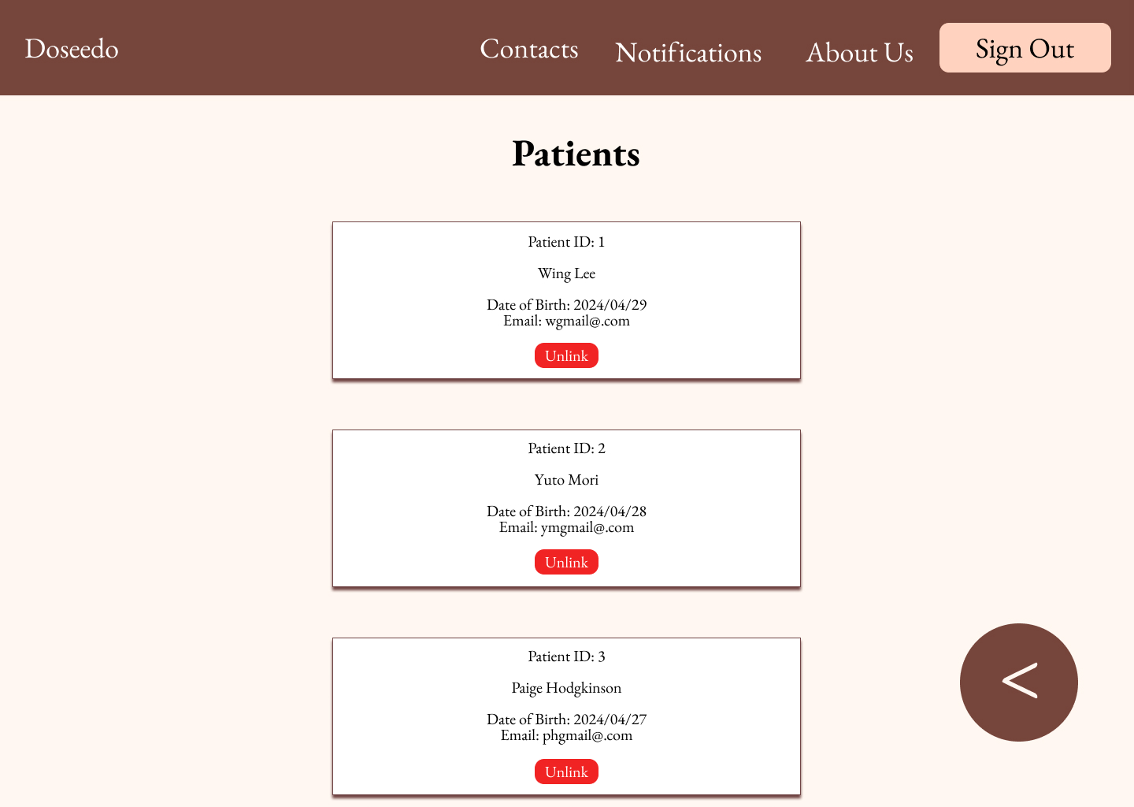
Figma Mockups

Slide 8
DEMO HERE

Slide 9
Doseedo P2/Future Features
0%
Check-in activity status for log in
Automatically update an “active today” at login
Calendar API
Calendar API to view all reminders
0%
Task Notification Bar
Next medication alert visible
0%
Texting for unfulfilled reminders sent to caregiver
Notify caregiver if alerts are ignored or null: “taken” after set amount of alerts
0%
0%
Phone call API for emergency contact
Ability to call emergency contact by clicking emergency contact button
“Insta-grandma” Photo Check-In
Photo Check-in at medication alert social
0%

Slide 10
Github Management

Slide 11
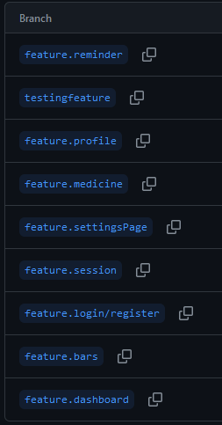
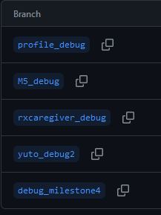
Branch Organization
Per Feature
Per Team Member
Per Debug Issue
Issues:
Conflicts due to two people working on a branch

Slide 12
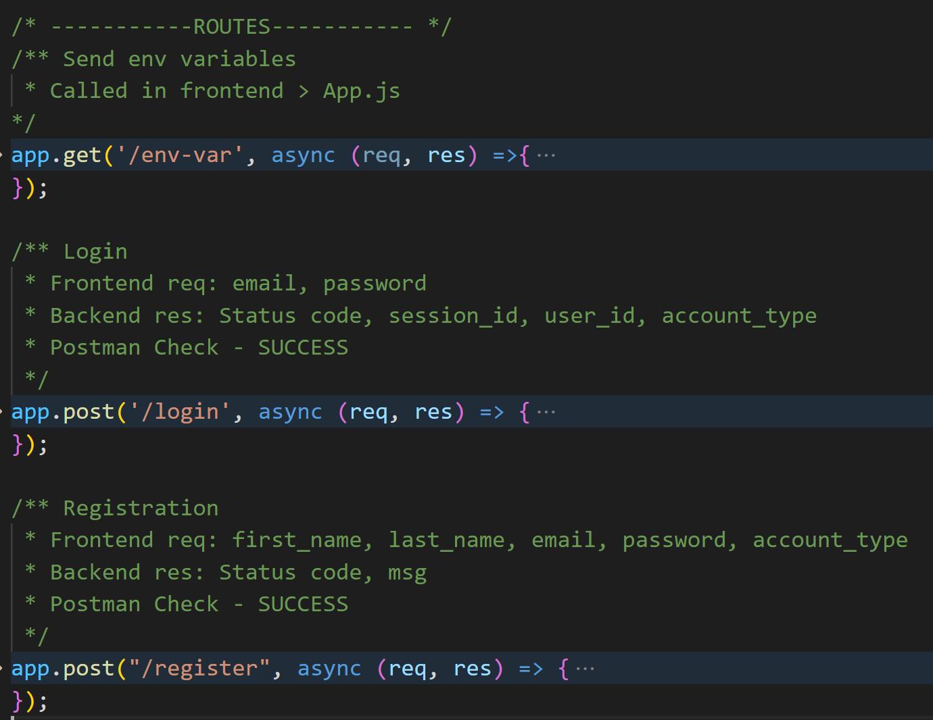
Commenting in Code
Not everyone is available 24/7
Expedite workflow
Clear communication of:
Frontend Request information
Backend Response information

Slide 13
Project Management

Slide 14
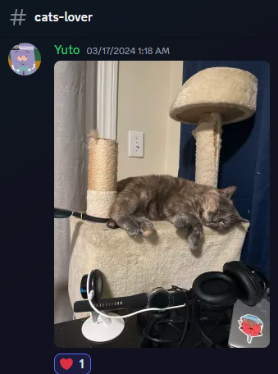
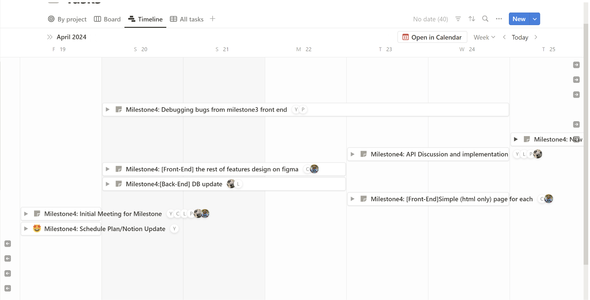
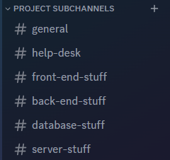
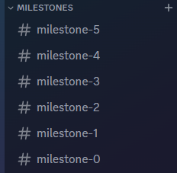
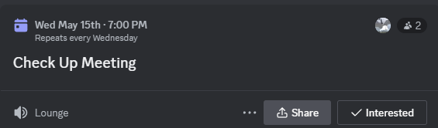
Notion & Discord
Use of both simultaneous for central communication and task management/documentation

Slide 15
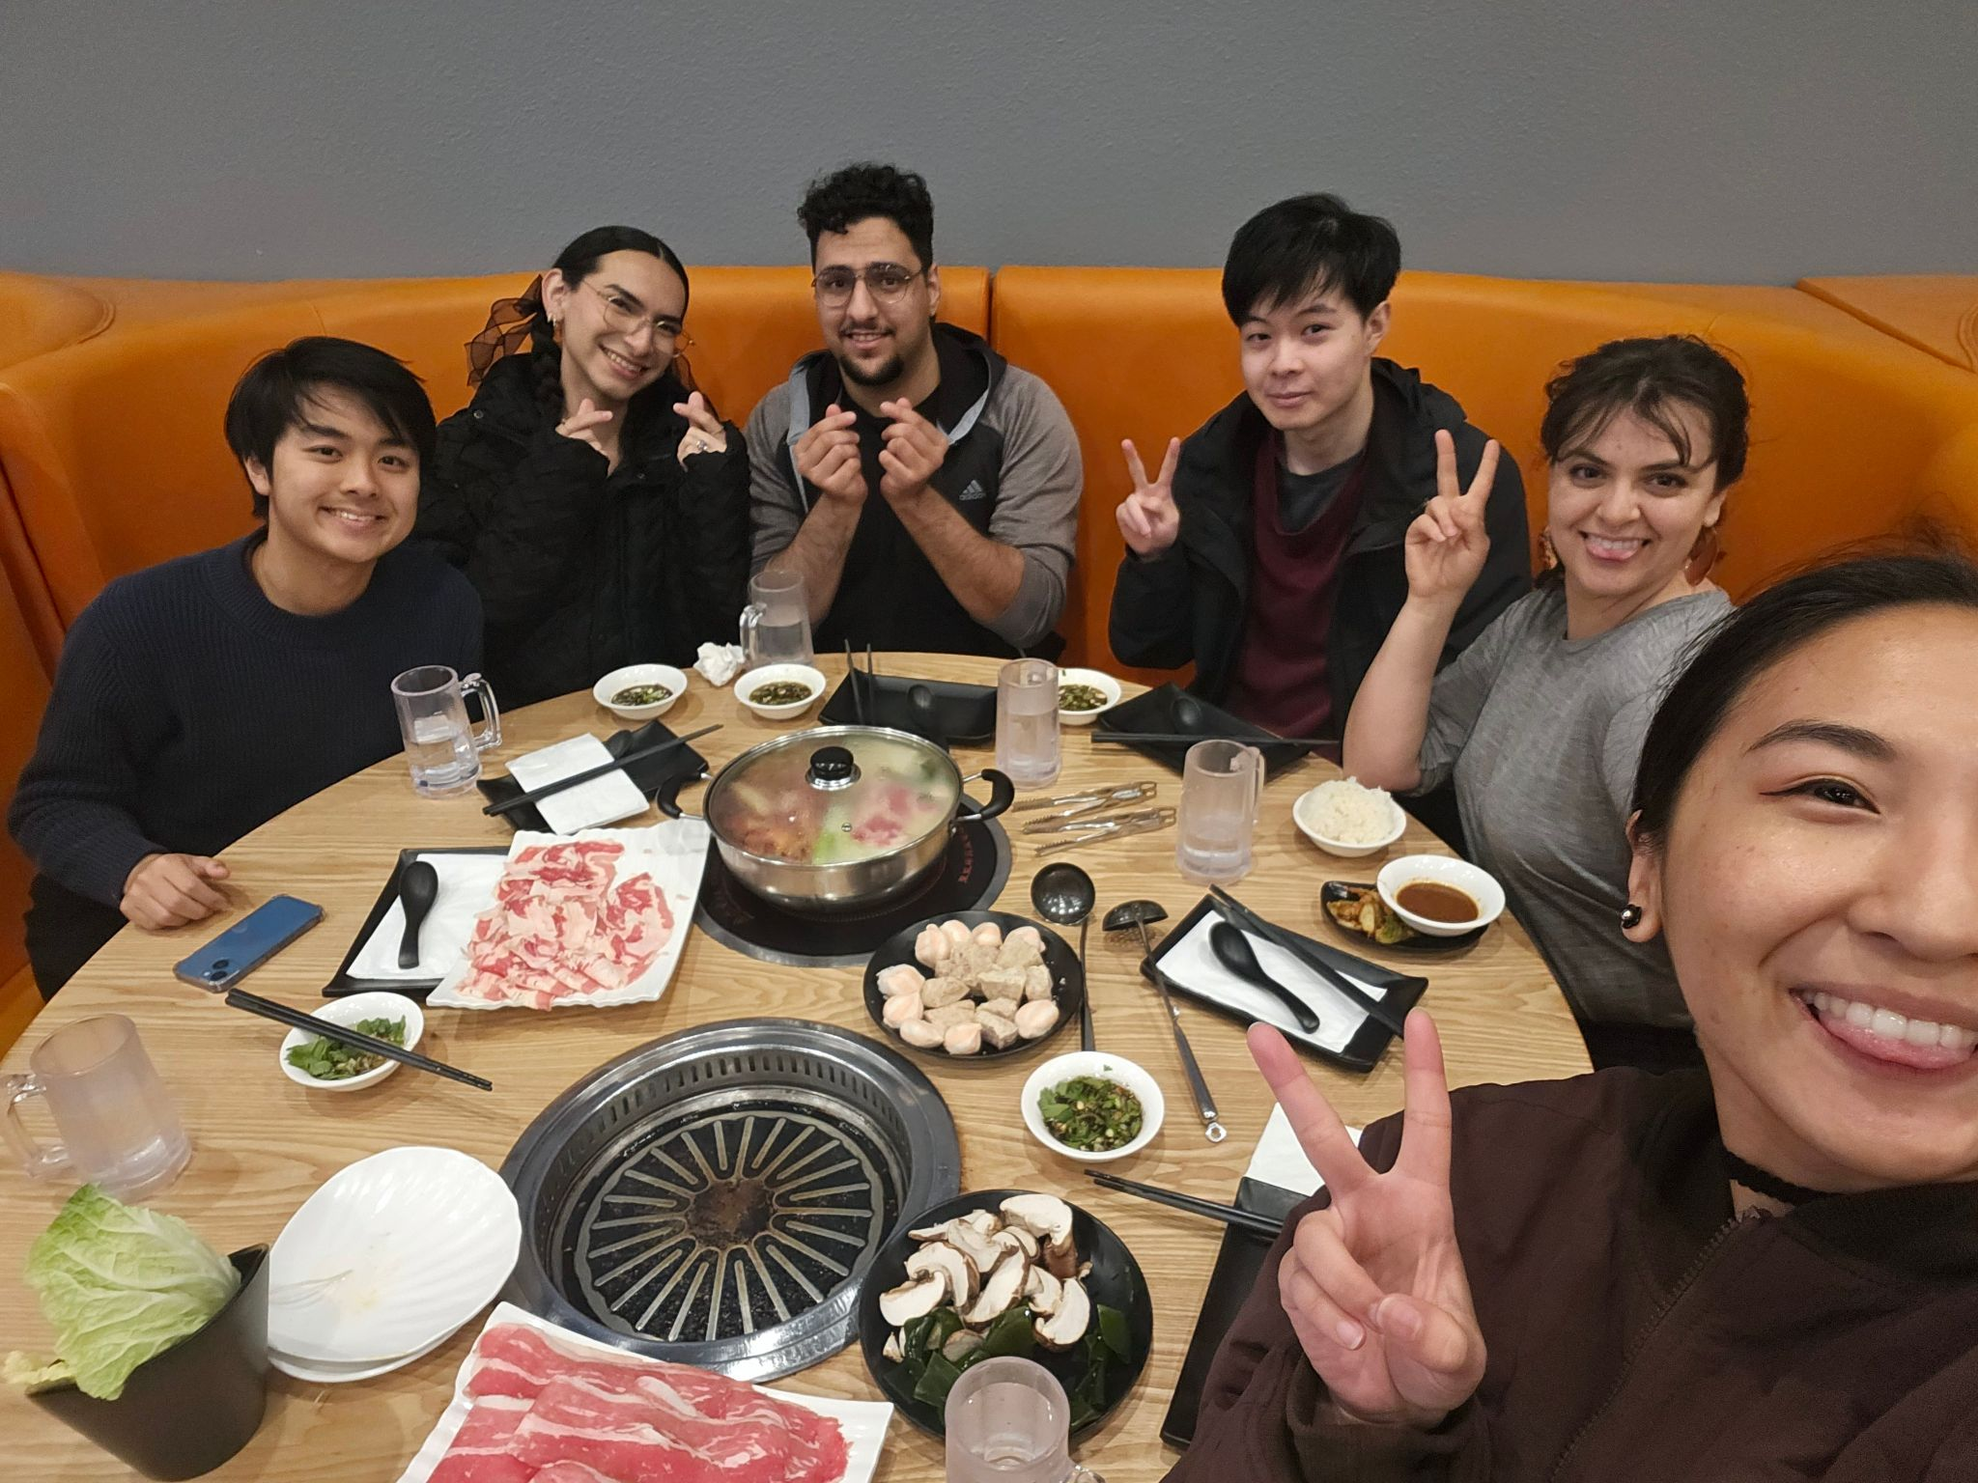


Team Building

Slide 16
Congratulations everyone!
We survived!
🥳
Thanks for being here 😊

